Slide 1
DESIGN pATTERNS
Command
Pattern
Group2

Slide 2
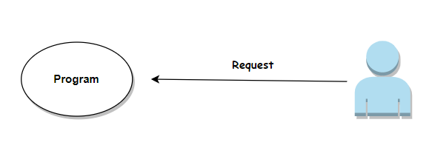
What is Design Pattern?
Design Patterns can be examined under 3 classes. These are
We can briefly summarize Design Patterns in Software Engineering as general repeatable solutions to commonly occurring problems.
Creational Design Patterns
Structural Design Patterns
Behavioral Design Patterns

Slide 3
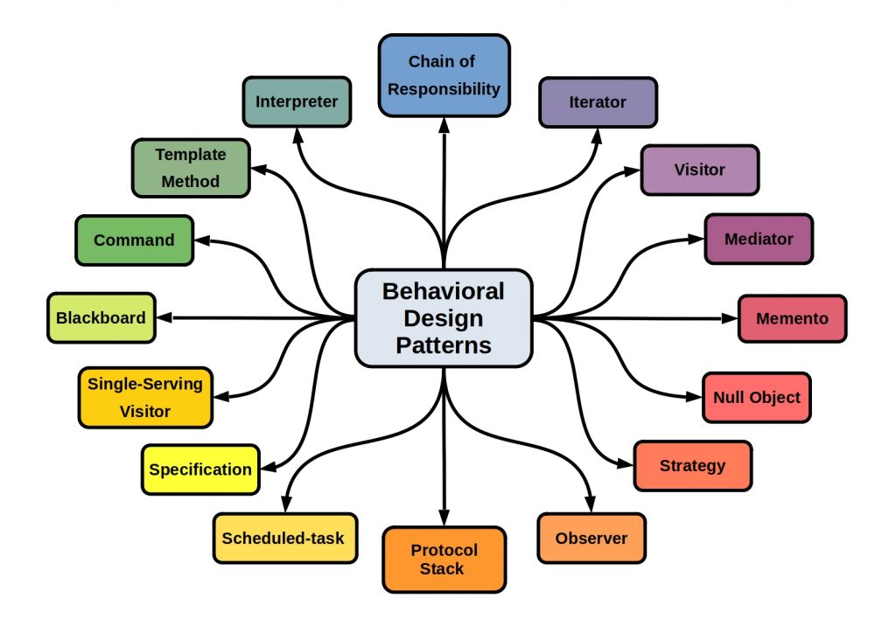
Behavioral Patterns
The most common explanation for these patterns is as follows.
“Behavioral design patterns are design patterns that identify common communication patterns among objects.”
Some examples of behavioral patterns are: Strategy Pattern, Observer Pattern, Template Method Pattern, Command Pattern etc.

Slide 4
What is Command Pattern?
“It encapsulates a request as an object thereby letting you parameterize other objects with different requests, queue or log requests.”
Furthermore, it supports undoable operations as well.

Slide 5


1
Command
Detailed Overview
2
Receiver
“thereby letting you parameterize other objects with different requests, queue or log requests.” What does it mean?
3
Invoker
When we are talking about command pattern, we are talking about 4 main terms (or naming conventions). These are
4
Client
Let's explain the concepts better through the example!

Slide 6

Wifi Connected Light Bulbs
Many of us have wifi-connected products in their homes. In this example, we will use wifi connected light bulbs. Let's imagine a lamp whose light can be increased, decreased and turned on or off by buttons of a remote controller. In addition to these features we are expected to change button functions via our mobile application. How do we design this system most effectively?

Slide 7
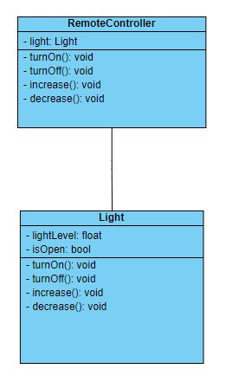
Poor Design
Usually the first thing that comes to our mind is creating a design like this.
So what's wrong here?
We adhere to concrete classes. From what we've seen in the lecture so far, we know that this is wrong.
We need to create a new function in Light class for each new function.
We put these functions in each lamp instance, but what if the lamp is not capable of performing some features.
Of course, we are free to apply the design we want. But how can we present a better design in this example?

Slide 8
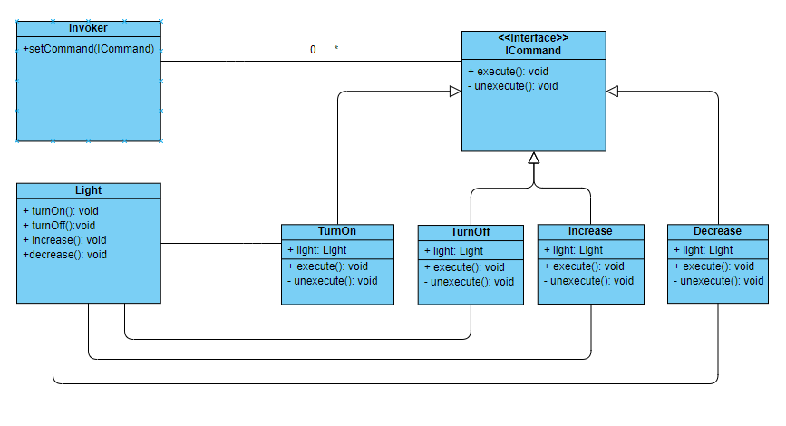
Design with Command Pattern

Slide 9
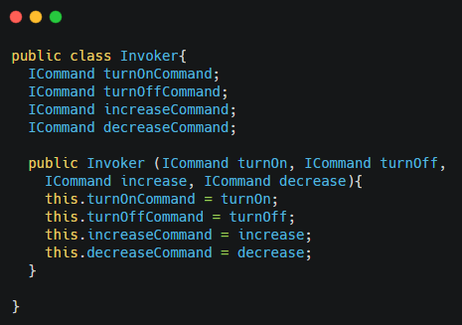
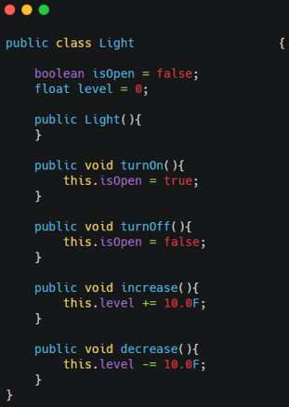
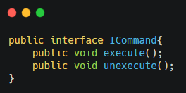
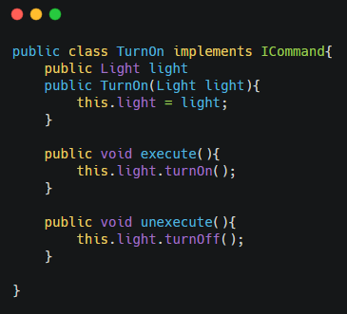
Example Code

Slide 10
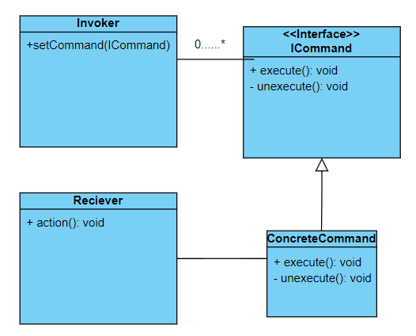
Generalized UML Diagram

Slide 11
Why Should I Use That?
It allows you to create a sequence of commands by providing a queue system.
Implementing extensions to add a new command is easy and can be done without changing the existing code.
It allows you to implement undo and redo operations.
Commands simplify the code and it makes it easier to use, understand and test the system.
It gives you a chance to execute request at different times.

Slide 12

Real Life Examples
So where can we apply the command pattern?
In user interfaces
In products with transactions such as Undo and Redo
While doing database operations
Wherever you think it is suitable!

Slide 13

Local Firestore
Local Firestore is an application that simulates object oriented, NOSQL database and it makes easy to operate on documents.
Our application deletes, adds and updates on collections and documents. All of these operations are implemented thanks to the encapsulation created by the command pattern.
In addition, our application offers undo and redo options to prevent data loss. The commit button is used to make the changes we make permanent.
If the user wishes, he/she can download the file in process as XML or JSON.

Slide 14
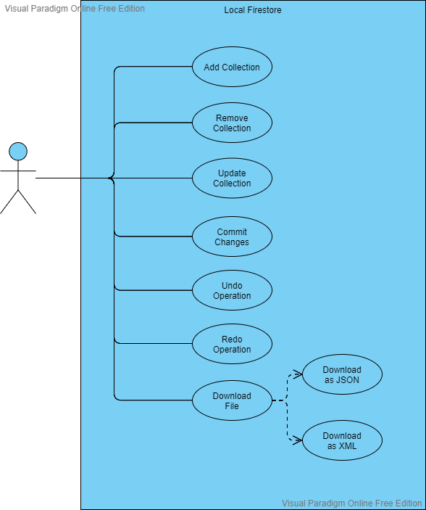
Use Case Diagram

Slide 15
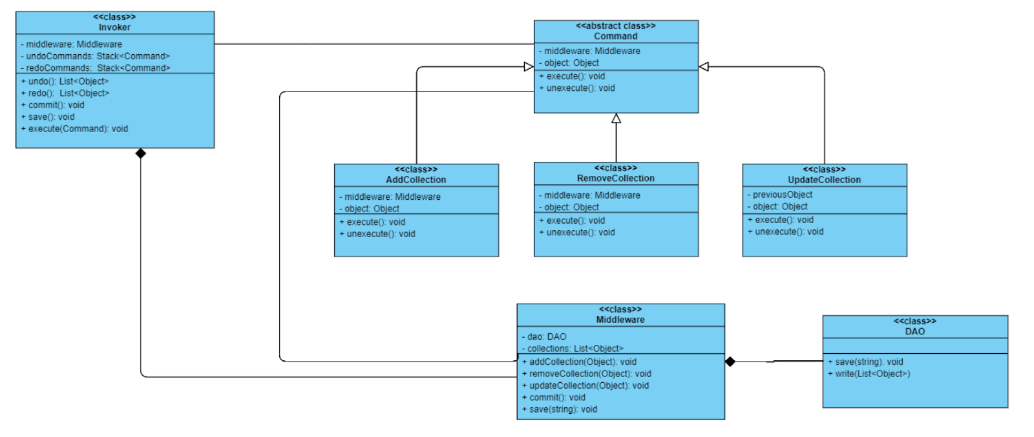
Class Diagram

Slide 16
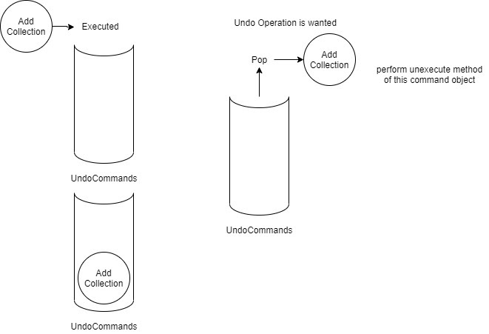
Undo Command Simulation

Slide 17
What Are The Differences?
1
Common usage of Command Pattern uses Command class as an interface in implementation. Why didn't we use it in that way? Why did we use as abstract class?
“Patterns are not rules. They are flexible structures according to our application.”
2
What is middleware class in our implementation? Why did we use that?
“Middleware is a structure that provides internal storage”

Slide 18

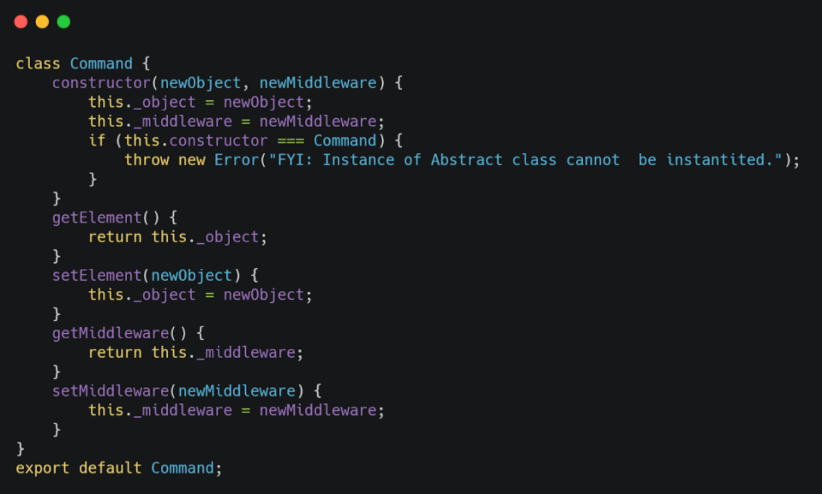
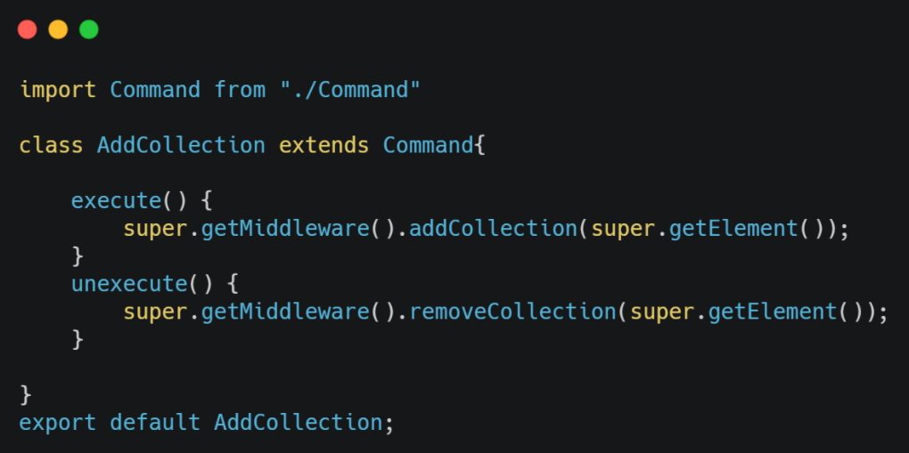
Let’s Dive into The Code! (1)
Command is an abstract class as we mentioned before. Middleware and object variables are kept in this class.
Add collection has execute and unexecute methods that assigns new collection to middleware’s appropriate function.

Slide 19
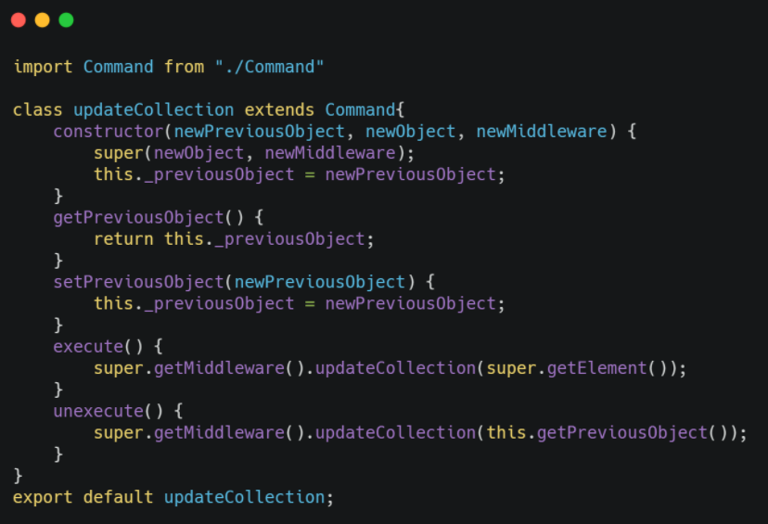
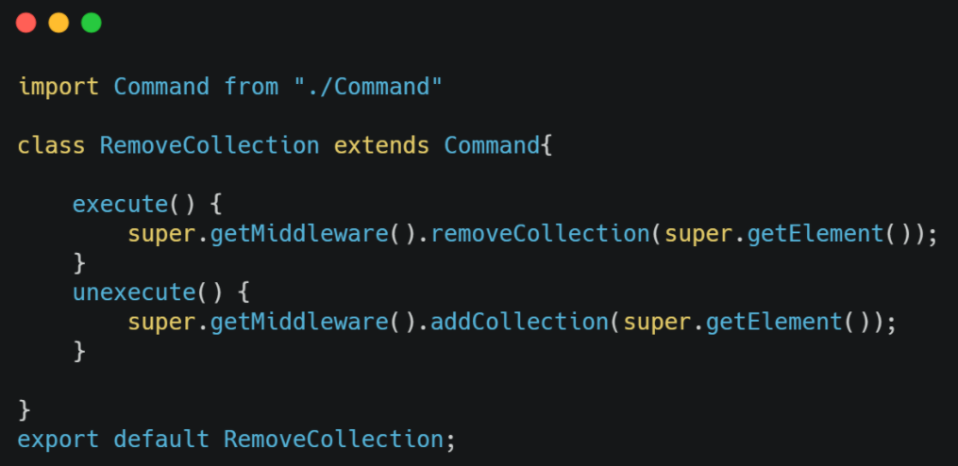
Let’s Dive into The Code (2)
Unlike other commands in the update collection, the previous version of the collections should also be kept. For this reason, we create a new constructor and keep an object called previous object.
In the execute function, the current version of the collection is placed into the data in the middleware. In unexecute function, the previous version of the collection is placed into the data in the middleware.
Remove collection command works in the opposite way of add collection command. While the data is deleted in the execute method, the data is added in the unexecute method.

Slide 20
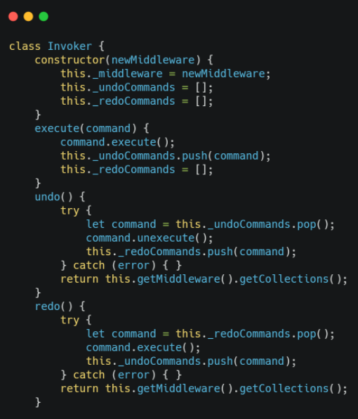
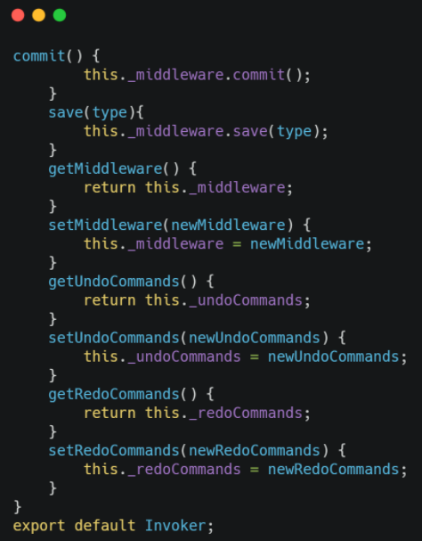
Let’s Dive into The Code (3)

Slide 21
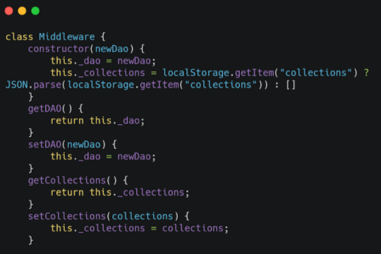
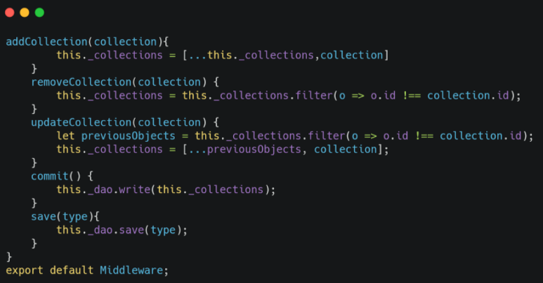
Let’s Dive into The Code (3)

Slide 22
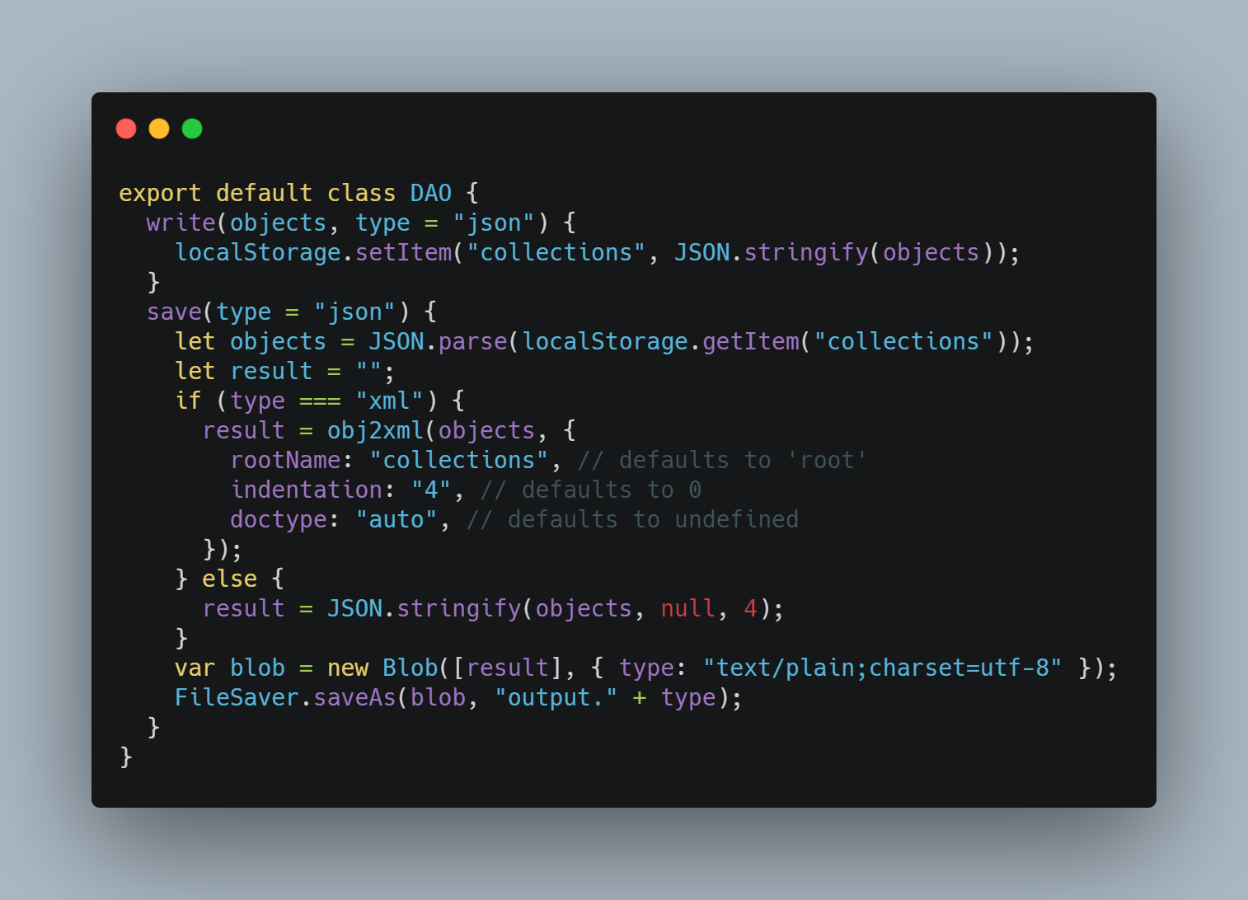
Let’s Dive into The Code (4)

Slide 23
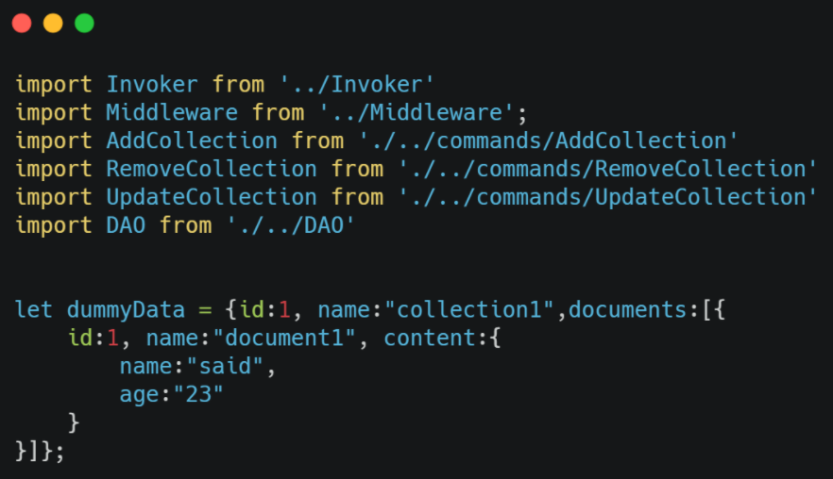
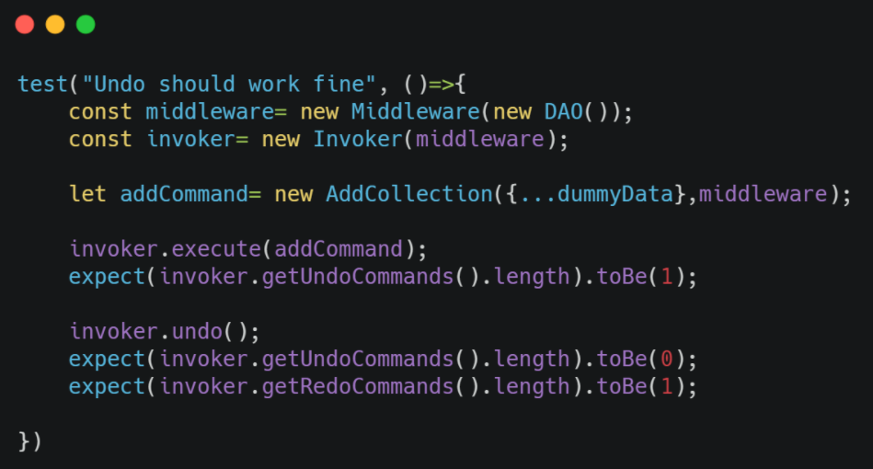
Let’s Dive into The Test (1)

Slide 24
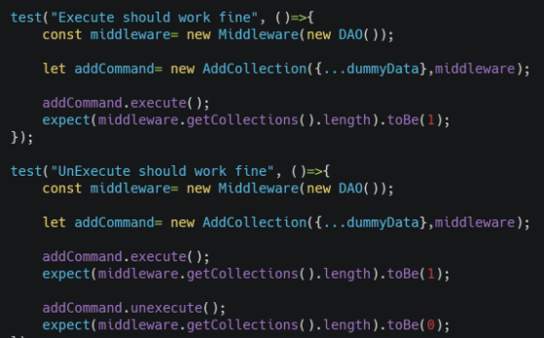
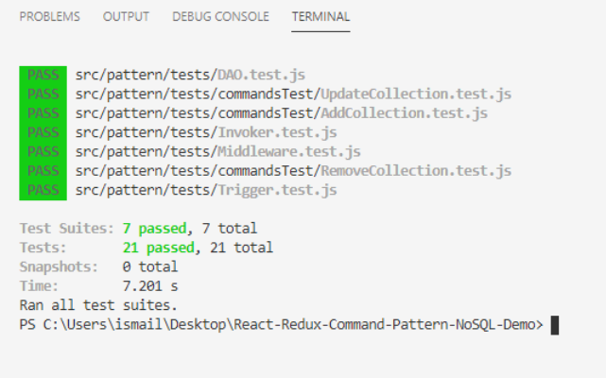
Let’s Dive into The Test (2)

Slide 25


Slide 26




Technologies Used
JavaScript
Redux
Programming Language
State Management
FIRESTORE
ReactJS
Jest
Library
( Mocha + Chai ) Testing

Slide 27

FIRESTORE
TEAM MEMBERS
Emre Hancı
Said Kaya
Eren Özger
İsmail Ateş
Mertcan Koçer
DEVELOPED BY ÜZÜMLÜKEK

Slide 28

Eren Özger
Said Kaya
Emre Hancı
İsmail Ateş
Mertcan koçer
Mertcan Koçer
Project manager
confıguratıon manager

Slide 29

Emre Hancı
Said Kaya
Eren Özger
İsmail Ateş
MUHAMMED SAİD KAYA
Mertcan Koçer
Software archıtect

Slide 30

Emre Hancı
Said Kaya
Eren Özger
ismail ateş
İsmail Ateş
Mertcan Koçer
Software tester

Slide 31

Emre Hancı
Eren Özger
Said Kaya
Eren özger
İsmail Ateş
Mertcan Koçer
Software analyst

Slide 32

Emre Hancı
Said Kaya
Eren Özger
Emre hancı
İsmail Ateş
Mertcan Koçer
Software analyst

Slide 33
THANKS FOR LISTENING US

